Slide 1
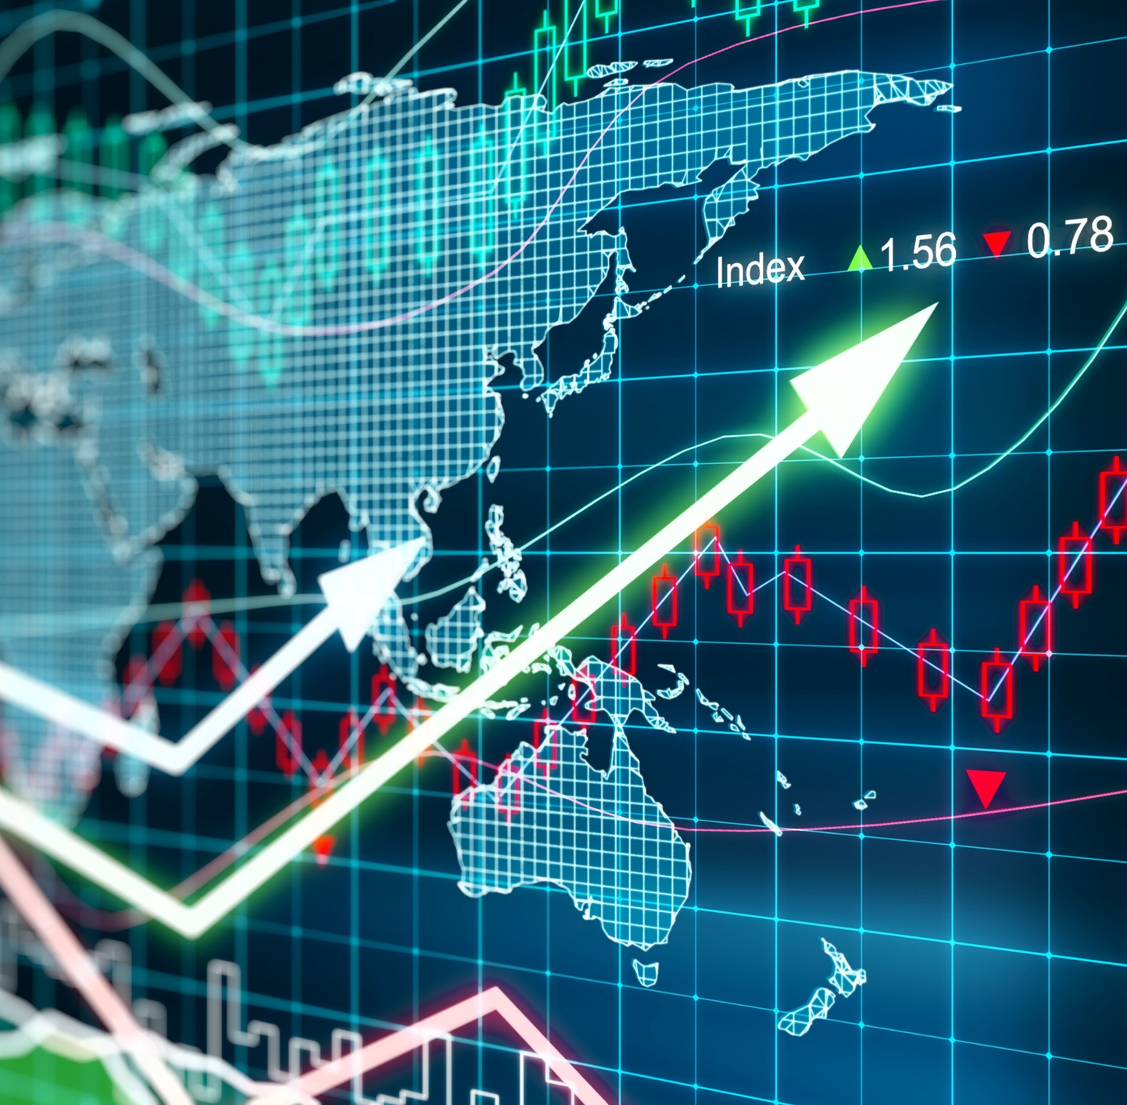
Stock Market Prediction using Granger’s causality test as a data pre-processor
By,
Akshay Dhonthi Ramesh Babu - 1887502
Fabian Humberto Fonseca Aponte - 1886565
David Esteban Imbajoa Ruiz - 1922212
Academic Year 2019 − 2020

Slide 2
Introduction
The stock market fluctuation is too rough and sometimes unpredictable even with proper tools and indicators. However, the future price prediction of a financial asset is essential for investors.
The future prediction can reduce the risk on decision of an appropriate investment asset. This kind of prediction can lead to gain in steady fortune.
Over the decade, large number of techniques has been developed out of which RNN has shown a great improvement.
Many times, the stocks of certain companies depend on others. Finding the correct causation between the companies can help in better predictions.

Slide 3
Objective
The presentation will cover the following section of the project:
Problem Statement: The purpose of the project.
Methodology: Methods and algorithms used
Experiments: Hypotheses and partial results of the performed experiments.
Results and Conclusion: Final results obtained and evaluation of the performance of the implementation.

Slide 4
Problem Statement
Develop a method that utilizes correlation between other companies to predict the future stock value of a specific company
Develop a stock market prediction algorithm for a specific company based on the past data and correlation with other companies

Slide 5

Methodology - Datasets
The dataset is loaded directly into python from Yahoo Finance using their API
A select number of companies (approx. 100) are chosen in advance
Each company has four time series data columns (open, high, low and close)
The dataset is structured into single dataframe with all the companies

Slide 6
Methodology
Preliminary Development
Prediction with LSTM (Individual)
Prediction with LSTM (Combined)
Prediction with BERT
Causation Matrix Development
Granger Causality test

Slide 7
Methodology - Preliminary Development

Slide 8
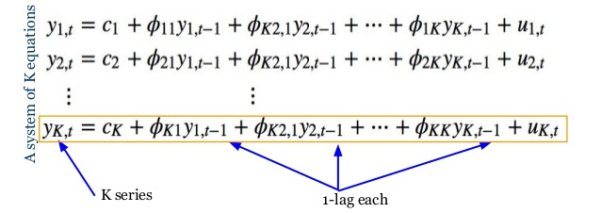
Methodology - Causation Matrix
Vector Autoregressive Model
This VAR model is a linear combination of past values of itself and the past values of other variables in the system.
As there are multiple time series that influence each other, VAR is modeled as a system of equations with one equation per time series.
For example, If there are two time serie, two compute one time series, the past values of both time series is used.
Image from: https://www.slideshare.net/databricks/time-series-forecasting-using-recurrent-neural-network-and-vector

Slide 9
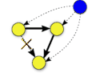
Methodology - Causation Matrix
Granger’s Causality Test
The idea behind VAR is to predict the series with past values of itself along with other series in the system.
Granger’s causality tests the null hypothesis that the coefficients of past values in the regression equation is zero
Image from: https://link.springer.com/chapter/10.1007/978-1-84996-196-7_5

Slide 10
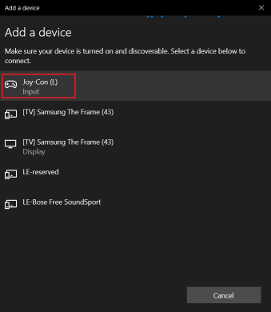
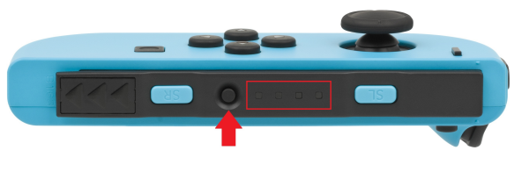
Configuration - Joystick
Bluetooth Communication
Activate bluetooth in the computer
Press the synchronization button on the Joycon
Search and add the device
There are two independent devices for both Joycons (left and right)
synchronization button

Slide 11
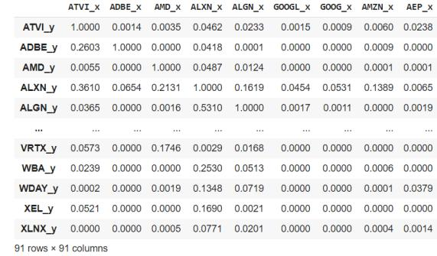
Implementation - Granger’s Causality test
The test is to check granger causality of all possible combinations of the n Time series. Where n is the number of companies.
The test returns an nXn matrix. With the rows being the time series in interest and the columns being the company to check if it affects the time series in interest based on the past values of both.
If the significance level is less than 0.05, then the the column time series does not cause the row time series.

Slide 12
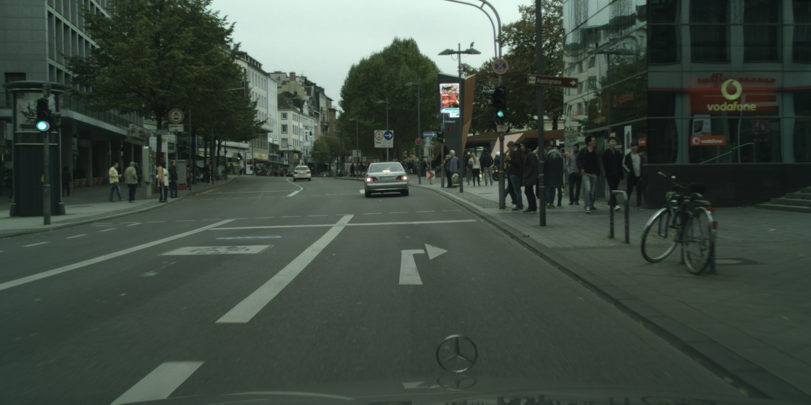
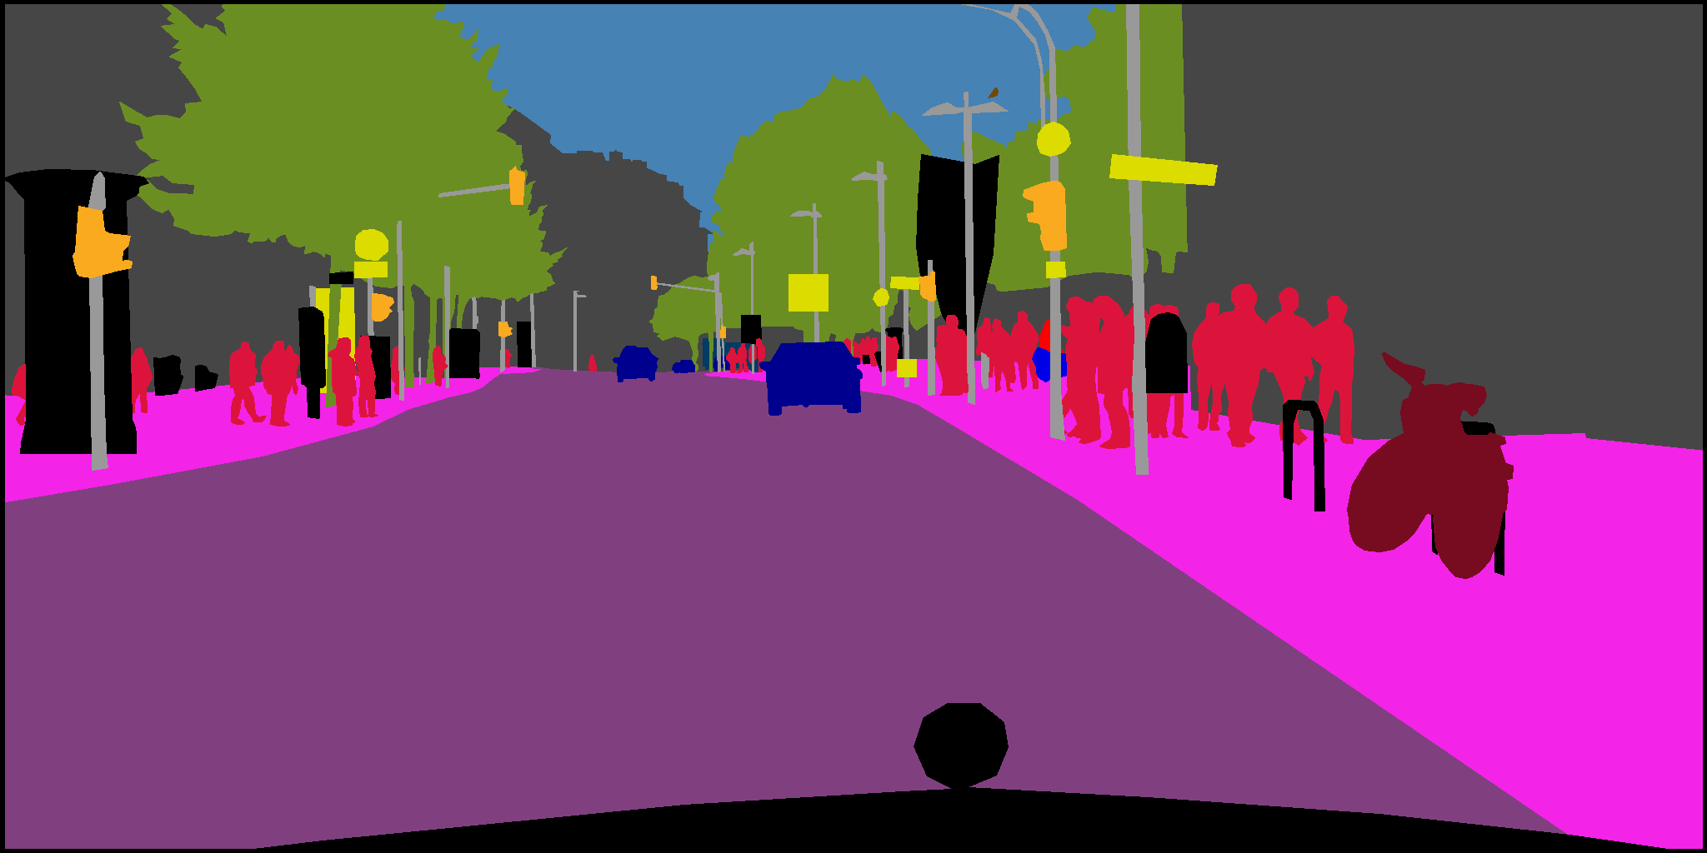
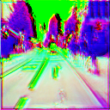
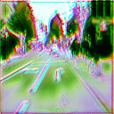
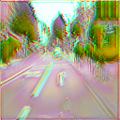
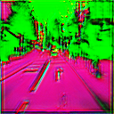
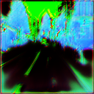
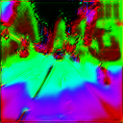
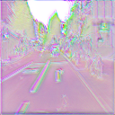
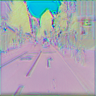
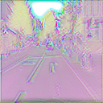
Implementation - Partial Results
Loss functions implementations with one image data set, 10 epochs and 128 pixels
Loss function Grad-GAN for Virtual-to-Real modified [1]:
Loss function Simple GAN:
Loss function Pix to Pix:
[1] Li, P., Liang, X., Jia, D., & Xing, E. P. (2018). Semantic-aware grad-gan for virtual-to-real urban scene adaption.
1 Epoch
5 Epoch
10 Epoch

Slide 13
Data Augmentation
Augmentation is implemented by using the imgaug, a python library for image augmentation in machine learning experiments. It supports a wide range of augmentation techniques, allows to easily combine these and to execute them in random order.
Commonly used Augmentation Techniques
Flipping | flip the image horizontally or vertically
Rotation | rotate the image by a given angle in the clockwise or anticlockwise direction
Cropping | during cropping, a section of the image is sampled randomly
Brightness | increase or decrease the brightness of the image
Scaling | images can be scaled outward or inward. When scaled outward, the image size increases while the image size decreases when scaled inwards.
Augmentations are applied in mini-batches and then fed to the model
Online Augmentation
Preferred for large datasets as the augmented images are not needed to be saved on the disc

Slide 14
Experimentation - Expected Results
To be filled
Initial Development
Causation Matrix Development
To be filled
Filtering with Causation Matrix
To be filled
Normalisation with Causation Matrix
To be filled

Slide 15
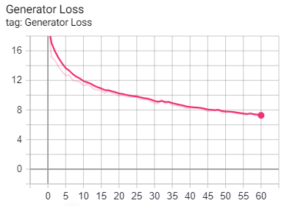
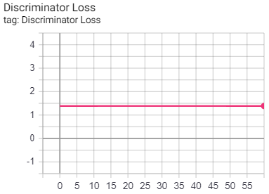
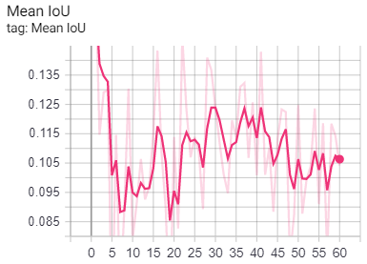
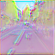
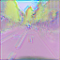
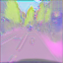
Experimentation
Image size: 64x64 pixels Batch size: 100 images Loss Function: Pix to pix Data Aug: Rand. Crop, Flip, Affine Transf. Training Time: 20 hours Epochs: 60
1 Epoch
30 Epoch
60 Epoch

Slide 16
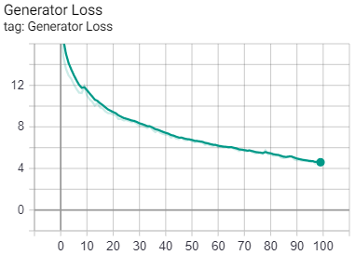
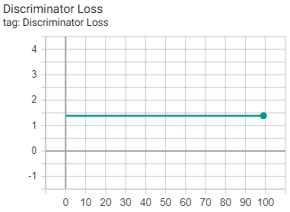
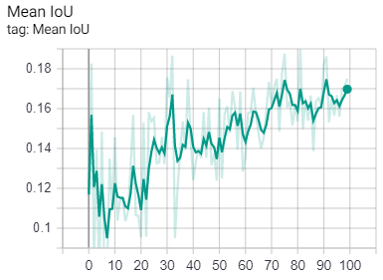
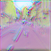
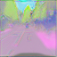

Experimentation
Image size: 64x64 pixels Batch size: 100 images Loss Function: Pix to pix Data Aug: None Training Time: 20 hours Epochs: 100
1 Epoch
50 Epoch
100 Epoch

Slide 17
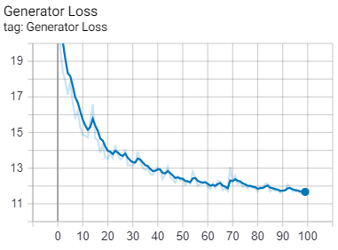
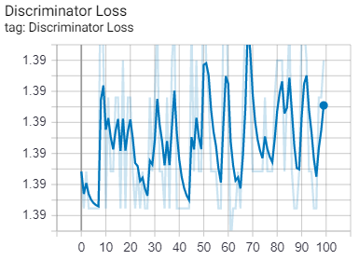
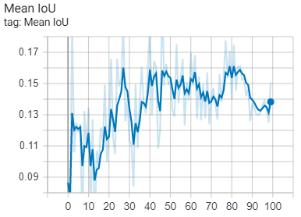
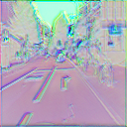
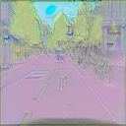
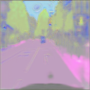
Experimentation
Image size: 128x128 pixels Batch size: 100 images Loss Function: Pix to pix Data Aug: None Training Time: 20 hours Epochs: 100
1 Epoch
50 Epoch
100 Epoch

Slide 18
Experimentation - Comments
V-REP Simulation
Real-time plots are shown from the data available in the framework which is an external API
Robot Control with Joystick
Switching between XY controla and Z control is not user friendly
Forces are very minor and mapping them on single armband is not easily understandable. It would be simpler on devices like GeoMagic
Force feedback on Armband
Robot Control with Armband Feedback
Armband provide very good and fast error feedback which helps in easy understanding of the situation
Robot Control with Dual Joystick
Dual joystick helps in simpler and faster control of the robot in all the directions

Slide 19
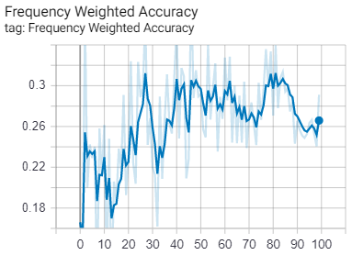
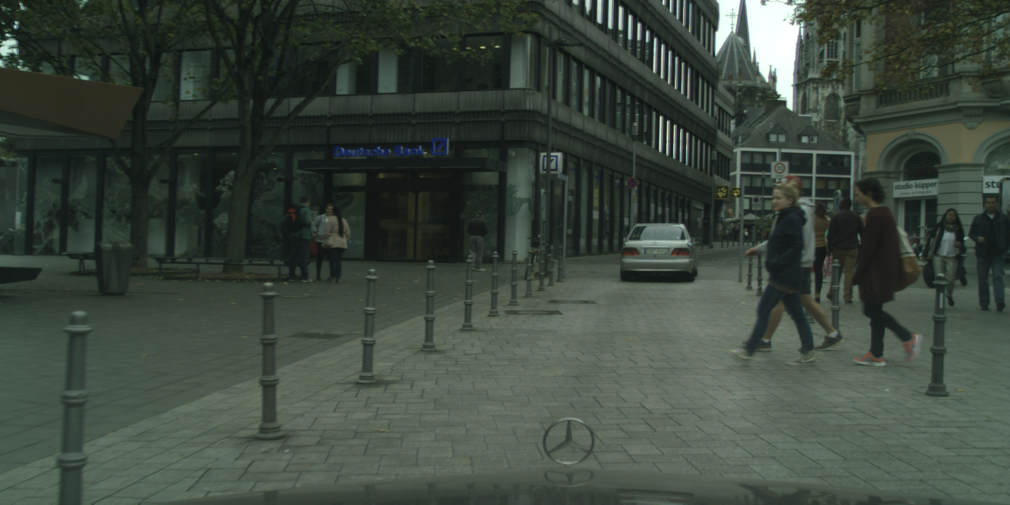
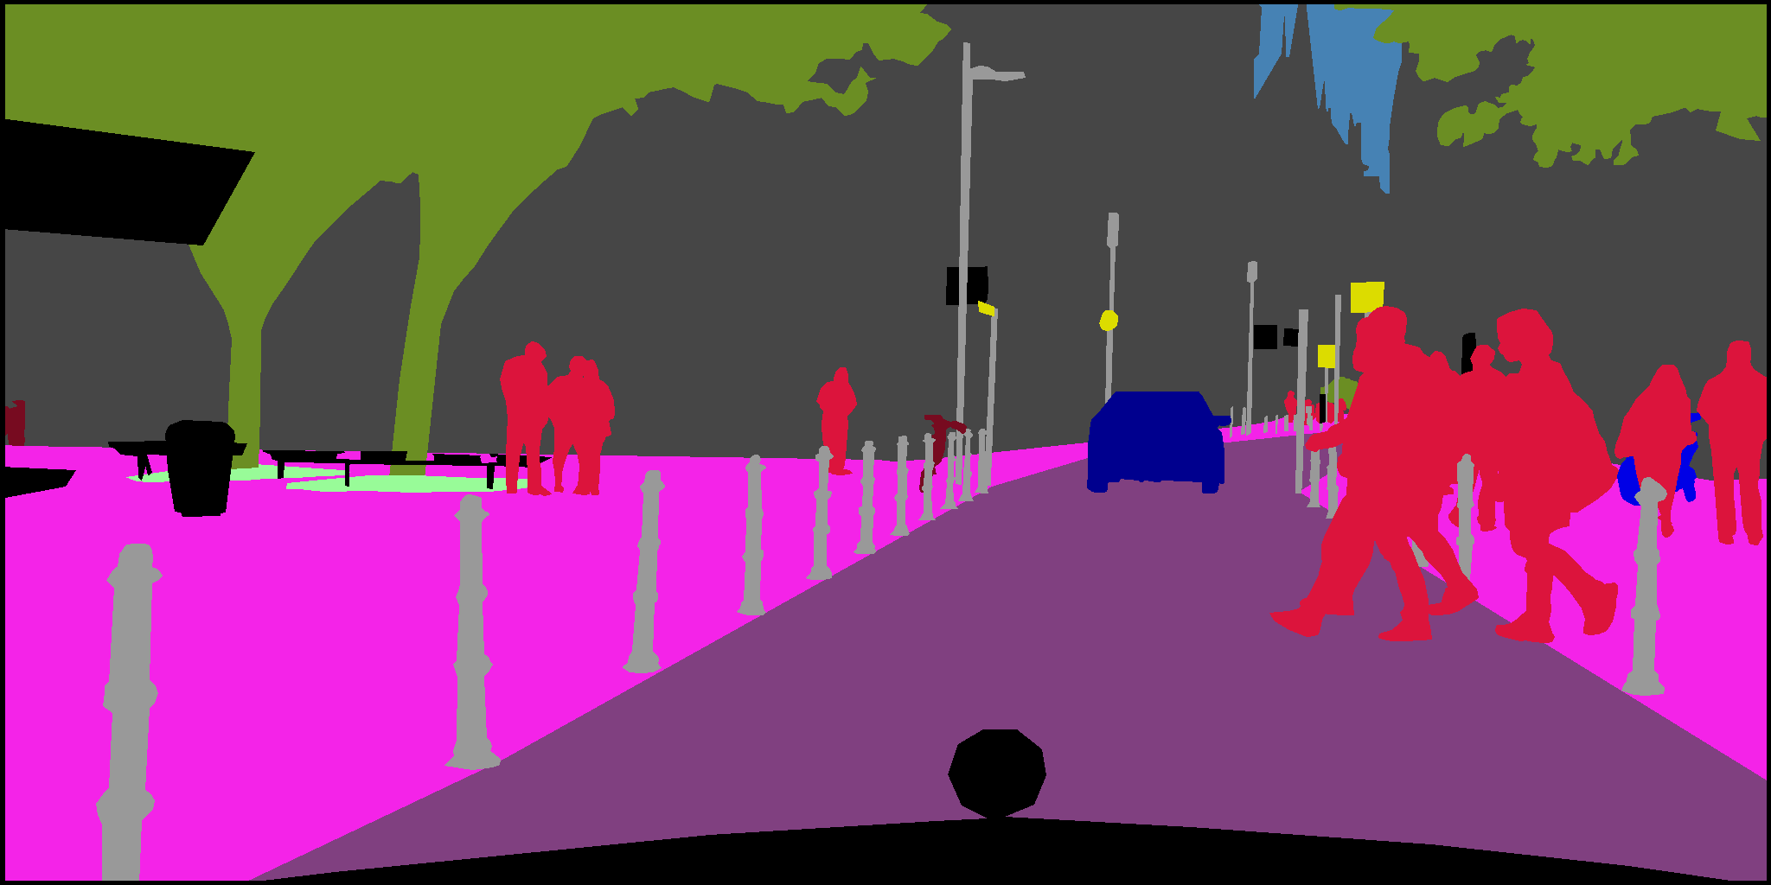
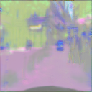
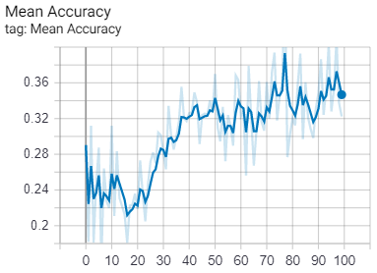
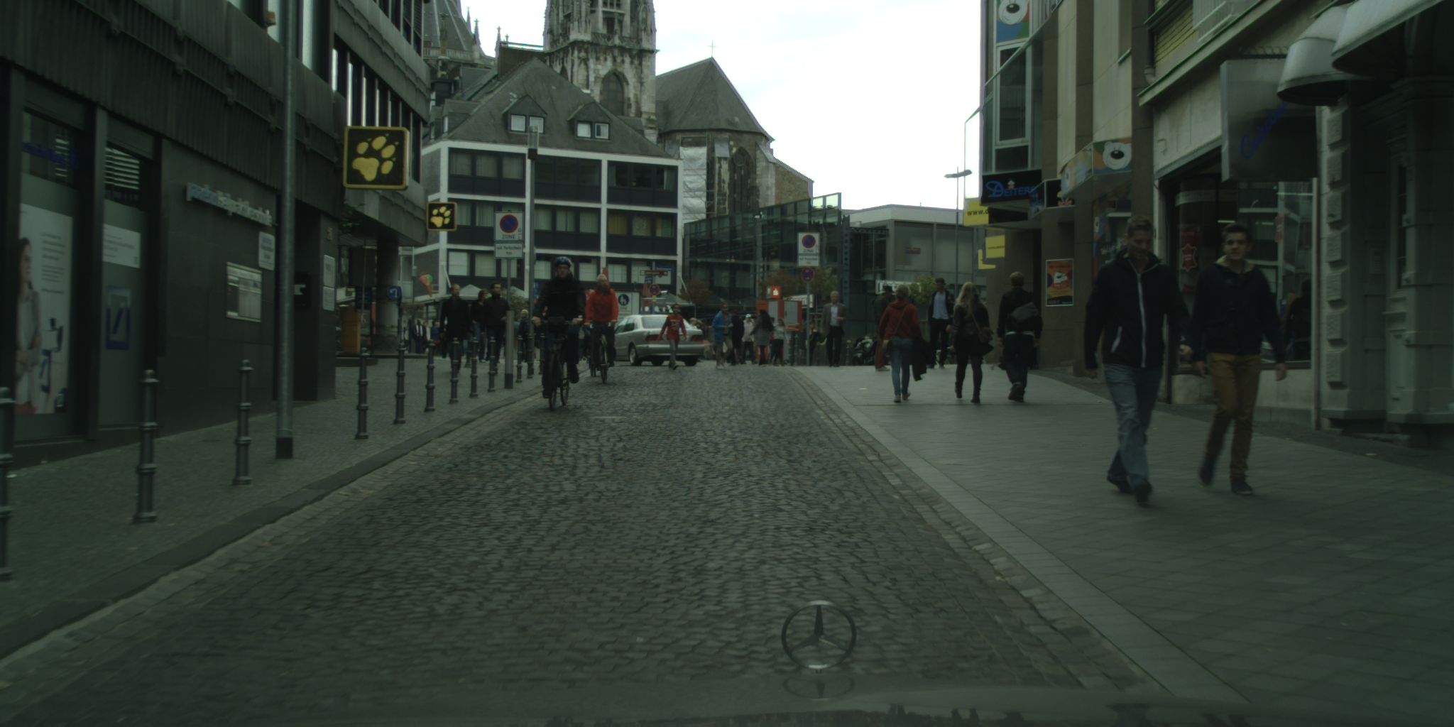
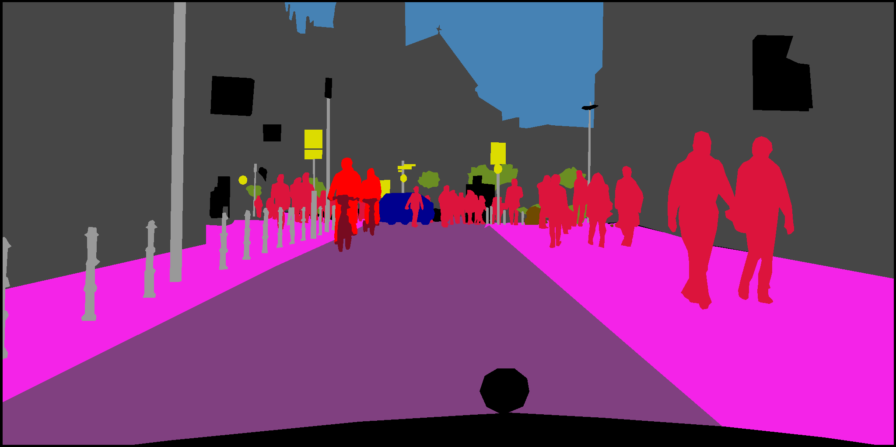
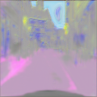
Results - Best Segmentator
Source Image
Ground Truth
Segmented Image

Slide 20
General results
It is possible to differentiate 5 classes in the segmentations generated by the neural model.
The 64x64 image size allowed experimenting with data augmentation without consuming all the computer resources.
It took at least 50 epochs to obtain images similar to those in the label space.
Generated Images
Using images larger than 128x128 pixels exhaust the computer resources and limits the experiments that can be performed with data augmentation.
The mean IoU curves indicated a better performance in the experiments without data augmentation.
Performance metrics

Slide 21
Conclusion
The data augmentation algorithms impair the final performance of the model as shown by the metric curves.
Reducing the size of the source image reduces the resources required for its training but limits the effectiveness achieved.
The pix to pix loss function was the one with the best predicted label space continuity and is suitable for semantic segmentation applications
Potential for improvement given better conditions in the data source and computational resources, such as more classes predicted and more detail in the generated image.
Re-implementation of the code in TensorFlow 2.0 updates to state of the art platforms, from which subsequent developments can be made
Reduction in complexity of the code and integration of other tools for performance analysis

